Slide 1
BIOMEDIN 215 Data Driven Medicine
Nigam Shah, MBBS, PhD
nigam@stanford.edu

Slide 2
Previous class:
A statistical model defines a class of possible data-generating probability distributions
Model fitting picks the distribution that’s most likely to have generated the data you see
Confidence intervals and hypothesis testing are ways to quantify variation in our estimate that comes from the randomness of sampling the data
To interpret findings ask:
What is the direction of the effect?
What is the effect size (is it clinically meaningful)?
How confident am I in my effect size estimate?
If you reject “nothing is going on”, that does not mean that your guess at “the thing going on” is relevant or accurate.

Slide 3
Goals for today
How do I choose an appropriate model for my data and question?
How do I deal with correlated measurements?
How do I identify multiple hypothesis scenarios and accordingly adjust p-values.

Slide 4
Choosing a Statistical Model

Slide 5
If your outcome variable is continuous
Use a statistical test that compares means
2 groups: t-test
≥ 2 groups: analysis of variance (ANOVA)
Null hypothesis: the difference in means is 0
Assumptions: Gaussian noise (matters when sample size is small); variance is homogeneous among groups compared
t-test, and ANOVA are special cases of linear regression

Slide 6
Linear regression
A linear model with more than one predictor
Allows adjustment for possible confounders
Interpret each coefficient as the change in the outcome per unit increase in that variable, with all other variables held constant
An Introduction to Statistical Learning - 2013
Notes:
Isolate the effect of X1 on Y, holding X2 constant

Slide 7
In an experimental study, does it make sense to assume that one variable could change without changing the others?
What about in an observational study?
How does that change your interpretation of the model coefficients in each case?

Slide 8
Linear regression hands-on

Slide 9

Logistic regression
Similar to linear regression, but fits a model for a categorical outcome variable
Uses the natural log of the odds (or logit) of the outcome as the dependent variable.
$$\ln\left(\frac{p}{1−p}\right)$$
X
Notes:
The logit is used because its mathematical properties are well suited for fitting a linear model to it – unlike a probability which can only have a value between 0 and 1, the natural log of the odds corresponding to that probability theoretically ranges between negative infinity and positive infinity

Slide 10
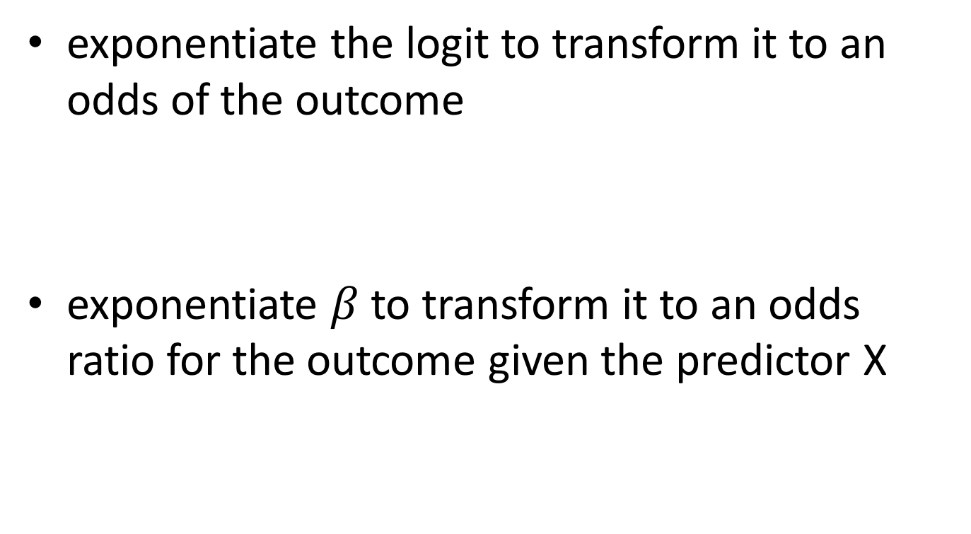


Going from logit to odds and odds ratio
exponentiate the logit to transform it to an odds of the outcome
exponentiate $β$ to transform it to an odds ratio for the outcome given the predictor X
$$odds = e^{ln⁡(\frac{p}{1−p}) }$$
$$OR= e^{β}$$

Slide 11



Interpreting the odds ratio
$$\ln\left(\frac{p}{1−p}\right)=α+β_{1}X_{1}+β_{2}X_{2}+β_{3}X_{3}$$
For every 1 unit increase in the predictor variable X₁ the odds of the outcome increase multiplicatively by $e^{β_{1}}$, controlling for all other predictors (X₂ and X₃)
$${OR}_{X1}= e^{β_{1}}$$

Slide 12
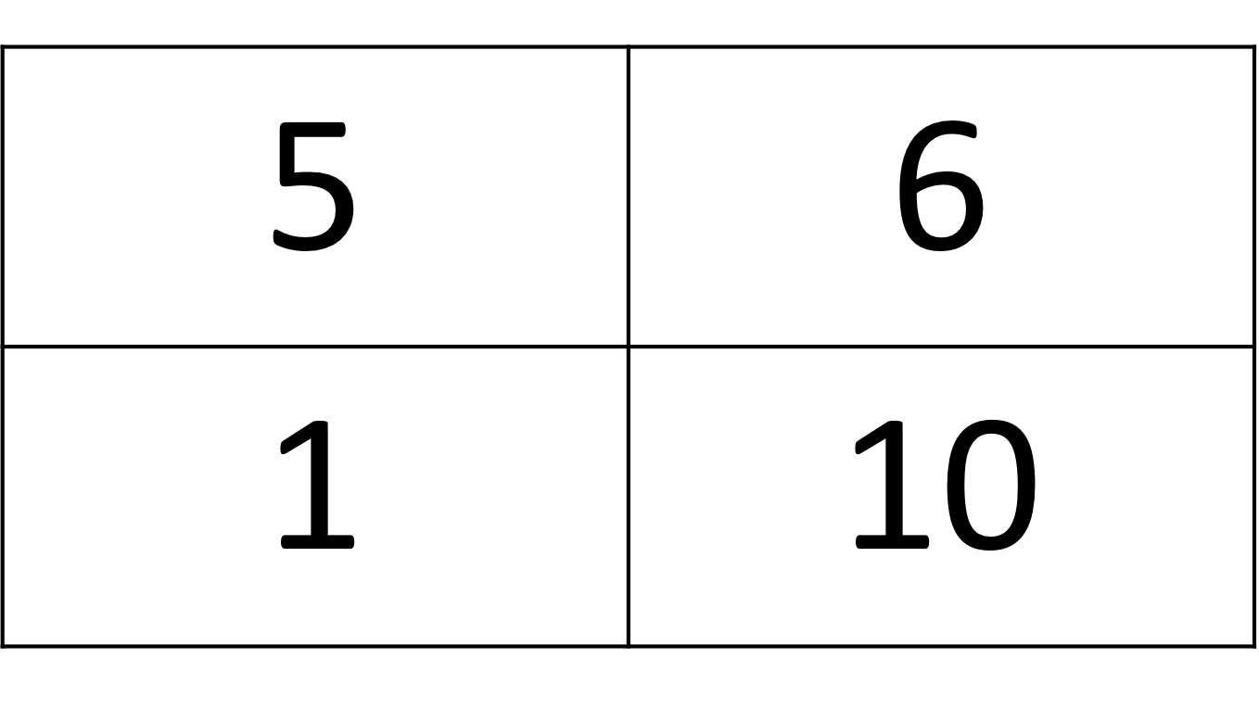
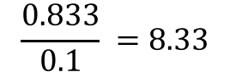
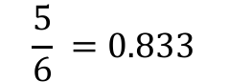
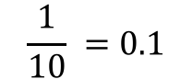
Relationship to odds ratios from 2x2 tables
heart attack
no heart attack
Exposed
controls
odds_{heart attack|exposed} =
$$\frac{5}{6} =0.833$$
odds_{heart attack|control} =
$$\frac{1}{10} =0.1$$
odds ratio =
$$\frac{0.833}{0.1} =8.33$$
Notes:
testing beta is not 0 is similar to a chi-squared test or fisher exact test that OR is not 1

Slide 13
Applications of logistic regression
Comparing response rates in cancer patients among treatment arms adjusted for age and duration of disease
Comparing the proportion of hypertensive patients between two treatment arms adjusted for age, cholesterol level and exercise habits
Walker G, Shostak J. Common Statistical Methods for Clinical Research with SAS Examples, Third Edition. Sas Inst; 2010.

Slide 14
Logistic regression hands-on

Slide 15
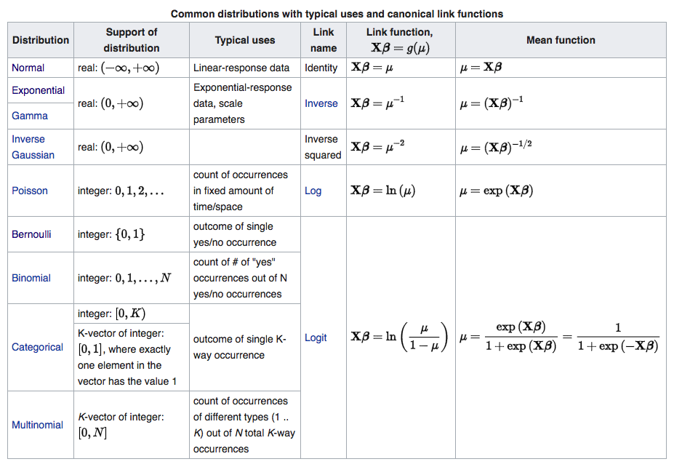
Other linear models

Slide 16
Generalized linear models (GLMs) let you work with many kinds of outcome data
A distribution from the exponential family
An appropriate “link function”

Slide 17
If your outcome variable is time-to-event
Do a survival analysis
Asks the question: how many people ‘survive’ event-free past a given time point? (the event does not have to be death, and can be a positive outcome)
Only possible by following people over time
Null hypothesis: rate of survival is the same in the two groups and that the two groups are not systematically different
Assumptions: e.g. both groups do not differ in their drop out rates.

Slide 18
Kaplan-Meier survival analysis
K-M curves are compared using the log-rank test, which compares the observed event rate to the expected event rate for each event time
Notes:
Takes into account loss to follow up (censoring). Event-free probability at each time point is calculated using participants still followed

Slide 19

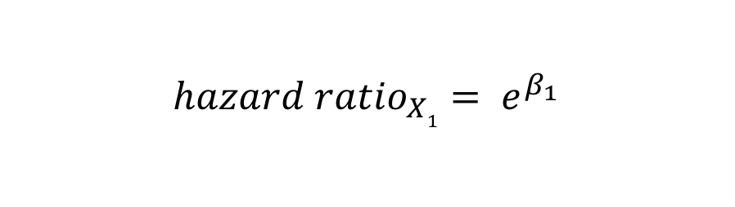

Cox regression
Multivariate regression for a time-to-event outcome
the underlying hazard function, describe how the hazard (risk) changes over time at baseline levels of covariates
the effect parameters, describe how the hazard varies in response to explanatory covariates.
Cumulative hazard at a time t is the risk of dying between time 0 and time t,
$$H{(t)}=H0(t) e^{(β_{1}X_{1}+β_{2}X_{2}+β_{3}X_{3}) }$$
$$\ln\left(\frac{H(t)}{H_{0}(t)}\right)=β_{1}X_{1}+β_{2}X_{2}+β_{3}X_{3}$$
$${hazard ratio}_{X1}= e^{β_{1}}$$
Notes:
Cox proportional hazards model
Relates the time that passes before some event occurs to one or more covariates that may be associated with that event
assumes that the effects of the predictor variables upon survival are constant over time and are multiplicative.
Two parts:
the underlying hazard function, describe how the hazard (risk) changes over time at baseline levels of covariates
the effect parameters, describe how the hazard varies in response to explanatory covariates.
Cox regression, models the incidence or hazard rate, the number of new cases of disease per population at-risk per unit time. If the outcome is death, this is the mortality rate. The hazard function is the probability that if a person survives to t, they will experience the event in the next instant.
Logistic regression in contrast, considers the proportion of new cases that develop in a given time period, i.e. the cumulative incidence. Logistic regression estimates the odds ratio; proportional hazards regression estimates the hazard ratio.
From: https://onlinecourses.science.psu.edu/stat507/node/81

Slide 20
Proportional hazards assumption
Hazard rate can change over time, and is therefore potentially complicated to model
Cox regression models the difference in hazard rate between groups, and assumes that this difference is constant over time
Notes:
The proportional hazards condition states that covariates are multiplicatively related to the hazard

Slide 21
Androgen deprivation & Dementia risk
Hazard ratio = 2.17; 95% CI, 1.58-2.99
Absolute risk:
7.9% among those who received ADT
3.5% in those who did not receive ADT
Notes:
We tested the effect of ADT on the risk of dementia using propensity score–matched Cox proportional hazards regression models and Kaplan-Meier survival analysis.
Our final cohort comprised 9272 individuals with prostate cancer, including 1826 men (19.7%) who received ADT.
Kaplan-Meier analysis demonstrated that ADT users 70 years or older had the lowest cumulative probability of remaining dementia free (log-rank P < .001).

Slide 22
Choosing the right statistical analyses
Outcome | Kind of analysis
 | Unadjusted | Adjusted
Continuous | t-test ANOVA | Linear regression
Categorical | chi-squared test Fisher exact test | logistic regression
Time-to-event | Log-rank test/ Kaplan-Meier curve | Cox proportional hazards regression

Slide 23
Models for Correlated Observations

Slide 24
Observations are often correlated with each other
Examples:
The pattern of 30-day readmissions may be different for different hospitals
A patient’s response to a drug is correlated with their twin’s response
The result of a lab test given to a patient in November is correlated with the result from October
The result of a repeated lab test on the same patient are correlated

Slide 25
Hierarchical models for groups
Patient (i) | Lab test (y) | Drug dose (x) | Testing Device (j)
1 | 41 | 7.2 | 1
2 | 57 | 7.4 | 2
3 | 8 | 7.3 | 1
4 | 6 | 6.2 | 2
5 | 14 | 4.2 | 3
6 | 88 | 6.8 | 1
7 | 92 | 5.4 | 2
… | … | … | …
Also called:
random/mixed effects
multi-level models
nested models
Allows for separate intercepts for each device to model biases!
Notes:
You can also include features about each device in the model for alpha!
You can have different slopes!
Allows for pooling
Interpreting random effects is hard
The simplest form of this is a two-group t-test with unpooled variance

Slide 26
Autoregressive models for correlations over time
Patient (i) | Lab test at time t (y) | Drug dose at time t (x) | Time (t)
1 | 41 | 7.2 | 1
1 | 57 | 7.4 | 2
1 | 8 | 7.3 | 1
1 | 6 | 6.2 | 2
2 | 14 | 4.2 | 3
2 | 88 | 6.8 | 1
2 | 92 | 5.4 | 2
… | … | … | …
Notes:
This is also a form of nesting

Slide 27
You can put it all together…
A generalized linear, autoregressive, hierarchical model

Slide 28
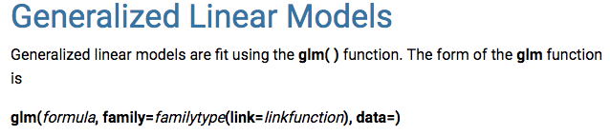
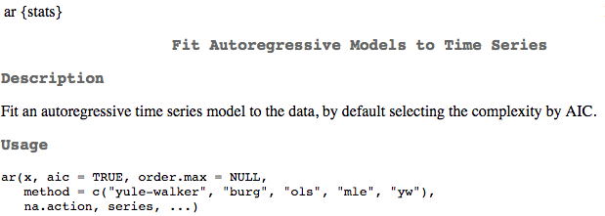
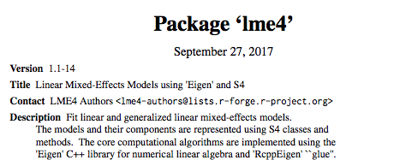
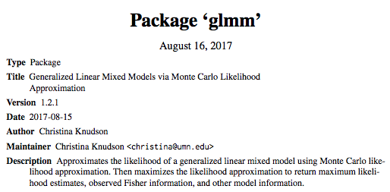
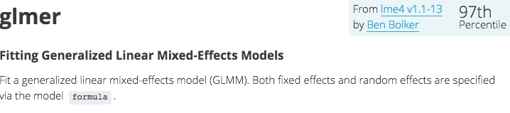
Packages to fit all of this crazy stuff
Notes:
The crazier your model gets, the harder it is to find the right software, but 95% of what you want is out there
Don’t be scared by fancy terms like Monte Carlo estimation, restricted maximum likelihood, etc. in software descriptions
These things are often computational tricks or approximations that make it easier to find the MLE or get something close to it
What you’re basically doing is still the same: finding the most likely set of parameters and how much you expect them to vary.
Say something about stats classes.

Slide 29
Multiple Hypothesis Testing

Slide 30
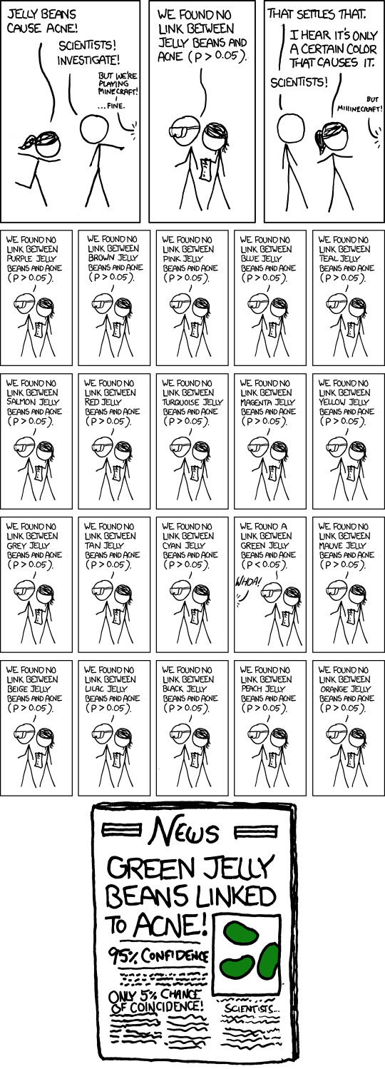

Slide 34
Multiple testing
More statistical tests = higher chance of a false positive finding
If the chance of a false positive finding for one test is 5%, the chance of a false positive when doing 20 such tests (assuming each test is independent) is
$$1−{\left(1−0.05\right)}^{20}=0.64 !$$
“Fishing expeditions”

Slide 35
What are some reasons multiple testing might be reasonably done in a study?
Take 2 minutes to discuss with the person beside you, and list 3 possible reasons.
Multiple outcomes
Multiple predictors
Multiple time points at which outcome observed

Slide 36
Correcting for multiple testing
Bonferroni correction
lowers threshold for statistical significance based on the number of tests you are doing e.g. 2 tests → 0.05/2 → 0.025 p-value cutoff
assumes that all tests are independent, which is not likely the case – highly conservative
Benjamini Hochberg procedure
Uses a set false discovery rate (⍺) to find a significance threshold for p-values
Tukey’s Honest Significant Difference (HSD) test
Determines if a difference in means is significant while controlling for false discovery rate

Slide 37
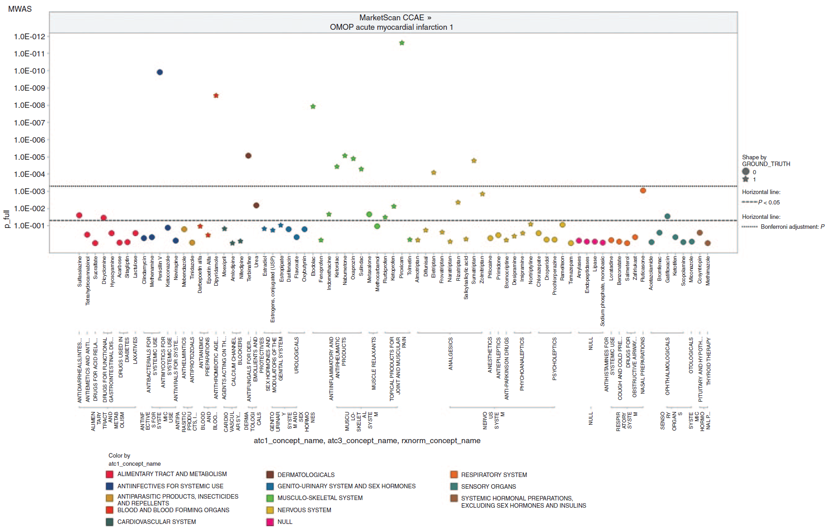
Multiple testing in practice - MWAS
Notes:
four health outcomes of interest in an administrative claims database of 46 million patients and a clinical database of 11 million patients.
The technique had good predictive value, but there was no threshold high enough to eliminate false-positive findings.
Calibration is the only sane way out to get an estimate of how likely are you to be wrong.
Problem is in creating good “negative control” sets.

Slide 38
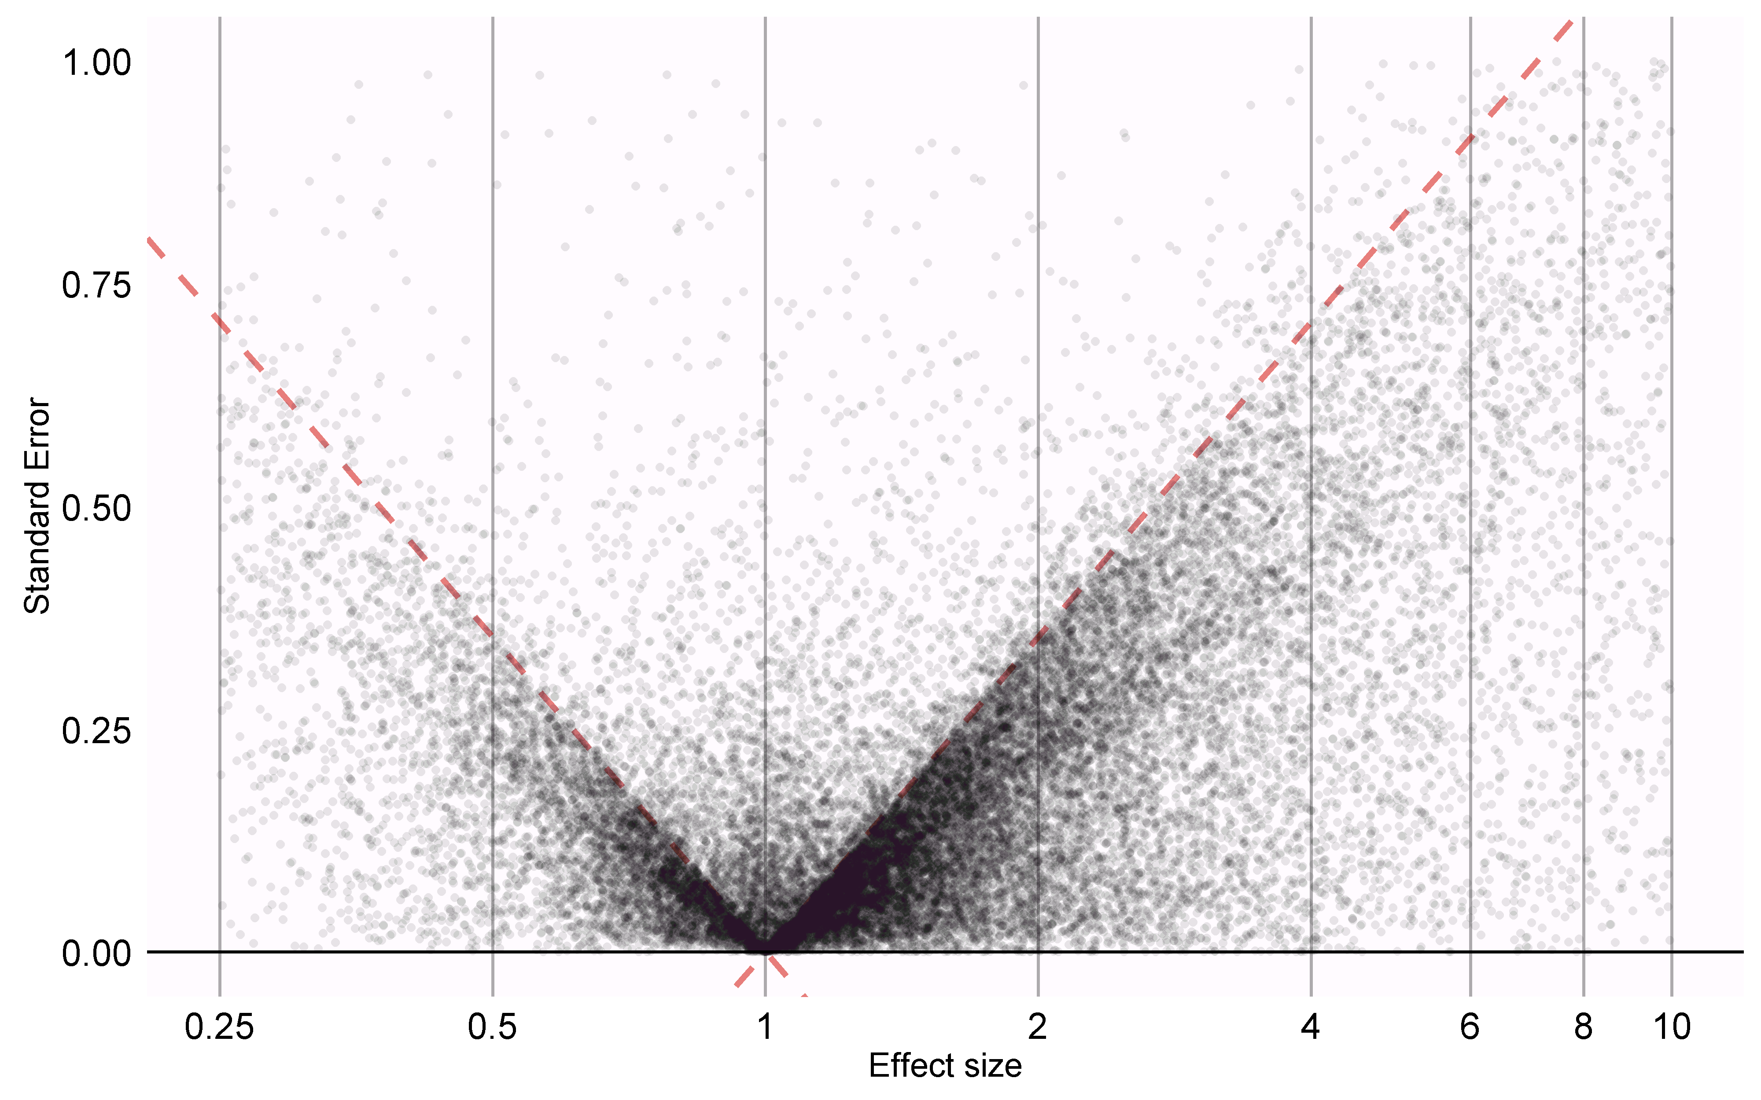
Observational research in literature (done one at a time)
85% of exposure-outcome pairs have p < 0.05
Lack of calibration
p-value hacking
29,982 estimates
11,758 papers

Slide 39
Remember:
There are models for different kinds of data
Use hierarchical or autoregressive models for correlated outcomes
Recognize multiple hypothesis scenarios and accordingly adjust p-values

